Slide 1
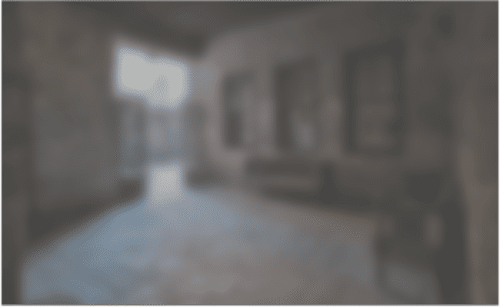

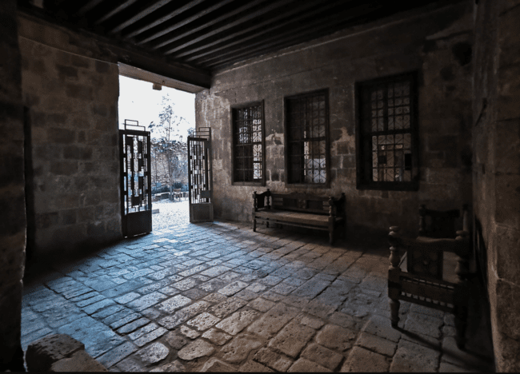


Hadeel Zakaria
ASE 4534
Architectural Photographic Techniques
Spring 26
VISIONARY BY DESIGN
A Photographic Journey
Through Beit Yakan
A Sequential Exploration of Space and Atmosphere
By: Hadeel Zakaria 220009
LOCATION
ABOUT BEIT YAKAN
START TOUR

Slide 2
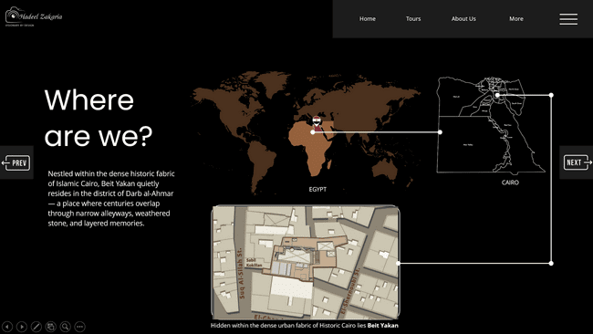
Hadeel Zakaria
ASE 4534
Architectural Photographic Techniques
Spring 26
VISIONARY BY DESIGN
A Photographic Journey
Through Beit Yakan
A Sequential Exploration of Space and Atmosphere
By: Hadeel Zakaria 220009
LOCATION
ABOUT BEIT YAKAN
START TOUR

Slide 3
Hadeel Zakaria
ASE 4534
Architectural Photographic Techniques
Spring 26
VISIONARY BY DESIGN
A Photographic Journey
Through Beit Yakan
A Sequential Exploration of Space and Atmosphere
By: Hadeel Zakaria 220009
LOCATION
START TOUR

Slide 4
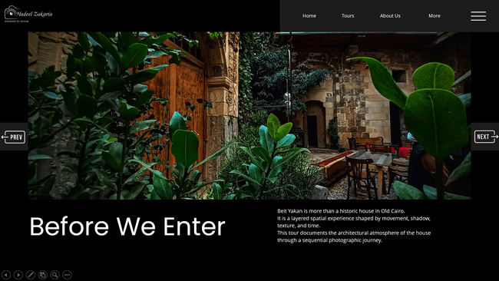
Hadeel Zakaria
ASE 4534
Architectural Photographic Techniques
Spring 26
VISIONARY BY DESIGN
A Photographic Journey
Through Beit Yakan
A Sequential Exploration of Space and Atmosphere
By: Hadeel Zakaria 220009
ABOUT BEIT YAKAN
LOCATION
START TOUR

Slide 5
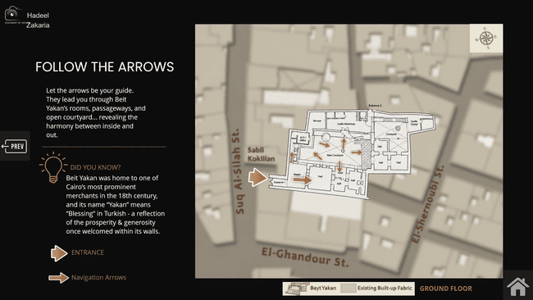
Hadeel Zakaria
ASE 4534
Architectural Photographic Techniques
Spring 26
VISIONARY BY DESIGN
A Photographic Journey
Through Beit Yakan
A Sequential Exploration of Space and Atmosphere
By: Hadeel Zakaria 220009
START TOUR
LOCATION
ABOUT BEIT YAKAN

Slide 6

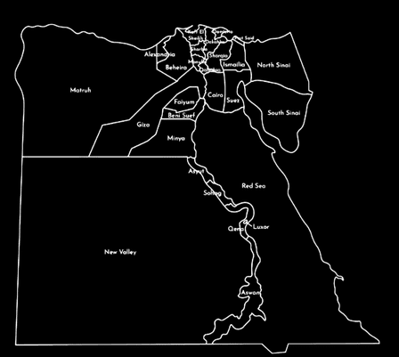


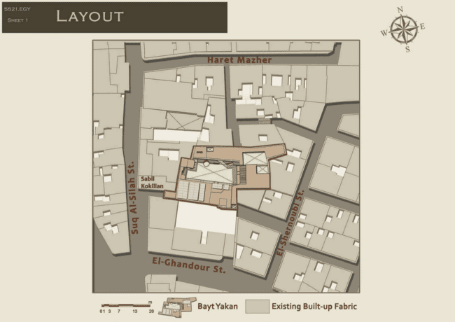

Hadeel Zakaria
VISIONARY BY DESIGN
Where
are we?
CAIRO
Nestled within the dense historic fabric of Islamic Cairo, Beit Yakan quietly resides in the district of Darb al-Ahmar — a place where centuries overlap through narrow alleyways, weathered stone, and layered memories.
EGYPT
Hidden within the dense urban fabric of Historic Cairo lies Beit Yakan

Slide 7
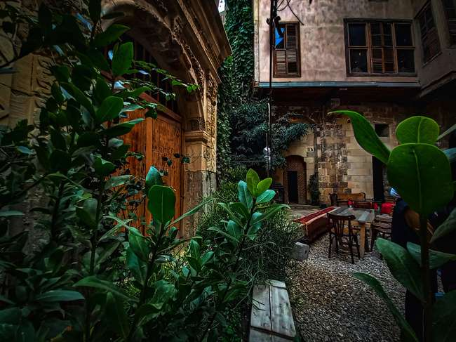
Hadeel Zakaria
VISIONARY BY DESIGN
Before We Enter
Beit Yakan is more than a historic house in Old Cairo.
It is a layered spatial experience shaped by movement, shadow, texture, and time.
This tour documents the architectural atmosphere of the house through a sequential photographic journey.

Slide 8
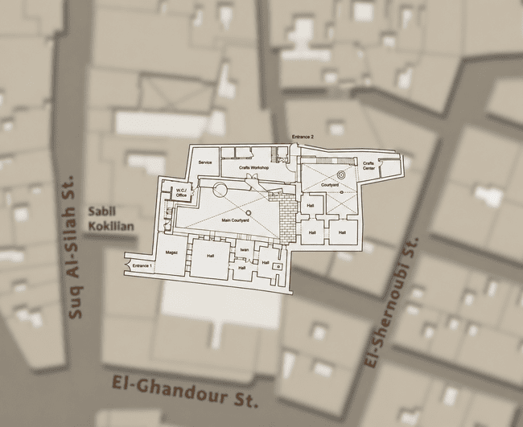



FOLLOW THE ARROWS
Let the arrows be your guide. They lead you through Beit Yakan’s rooms, passageways, and open courtyard... revealing the harmony between inside and out.
DID YOU KNOW?
Beit Yakan was home to one of Cairo’s most prominent merchants in the 18th century, and its name “Yakan” means “Blessing” in Turkish - a reflection of the prosperity & generosity once welcomed within its walls.
Click
to enter
ENTRANCE
Navigation Arrows
GROUND FLOOR

Slide 9
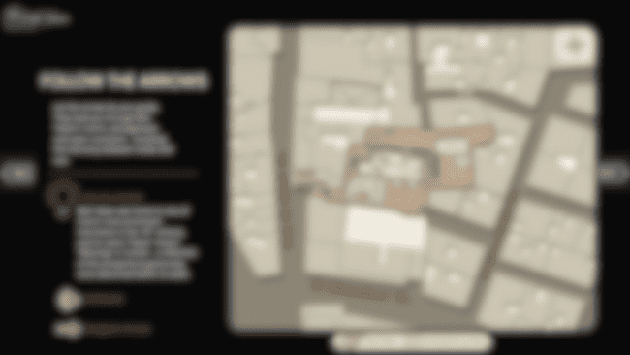
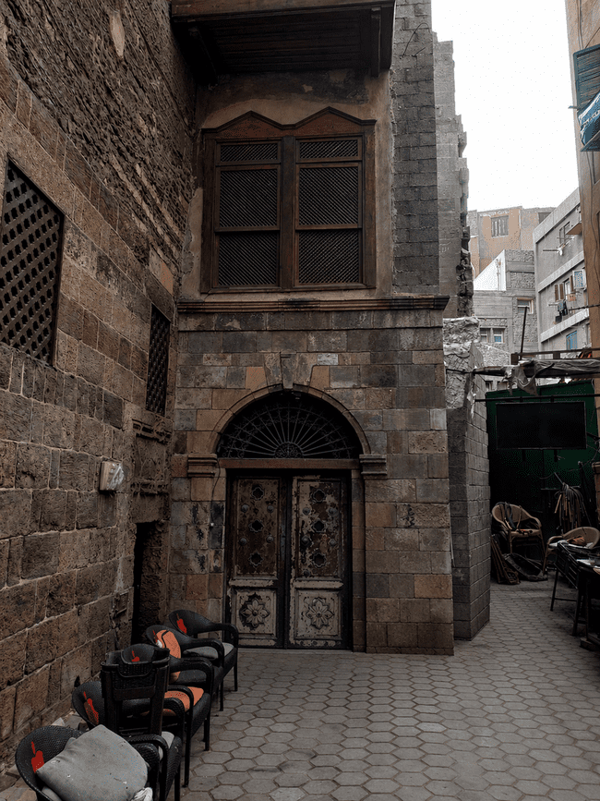




You’re here!
GROUND FLOOR
See inside
PLAN

Slide 10
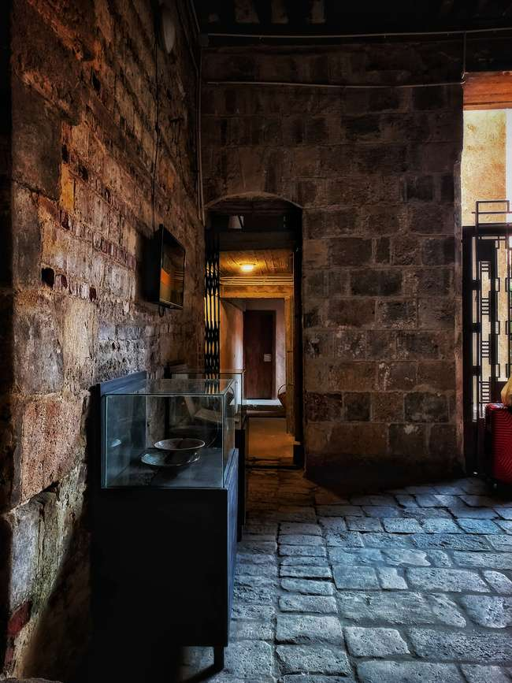
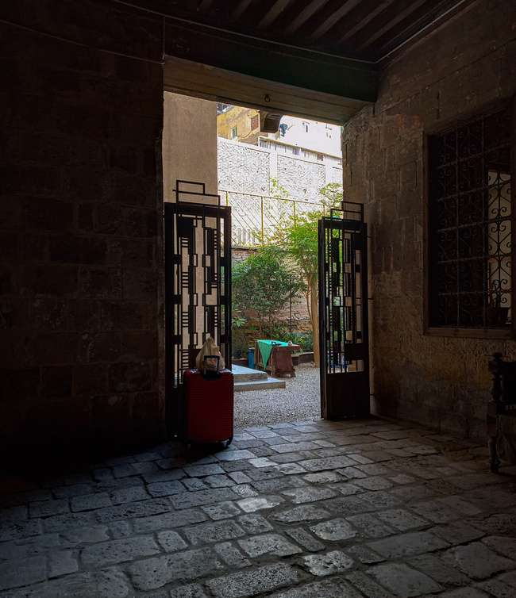
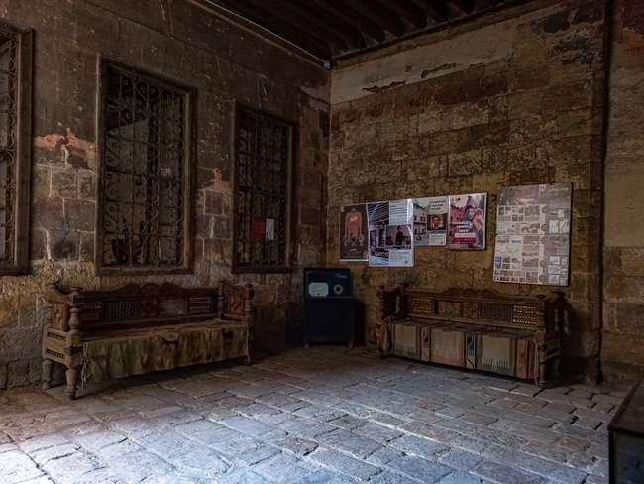
See inside
See outside
The interior of the Magaz seen once you enter
PLAN

Slide 11
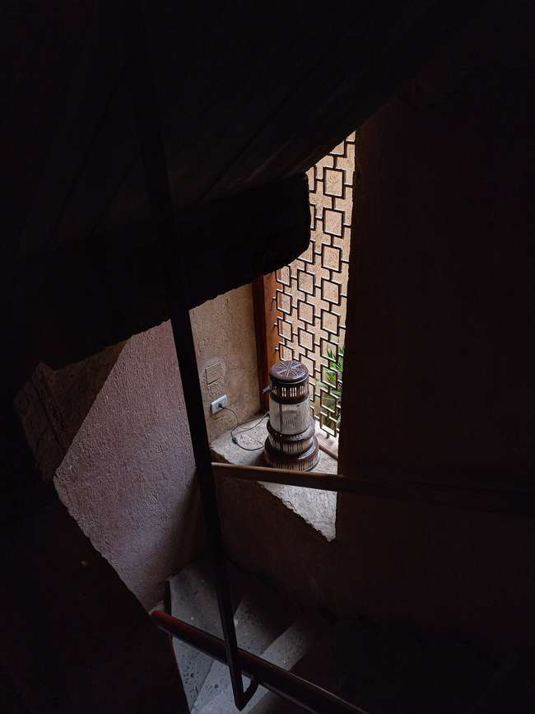
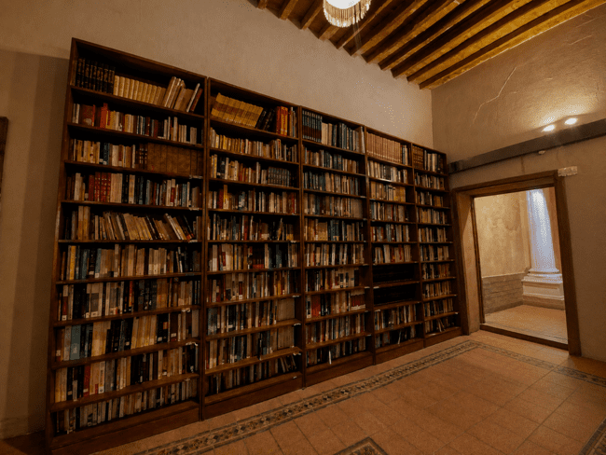
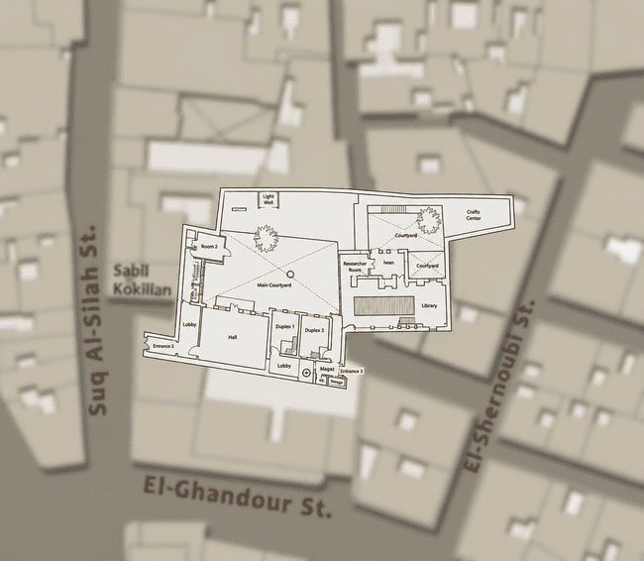
You’re here!
See inside
FIRST FLOOR
Taking the stairs at the end of the corridor
The stairs leads to a lobby with bookshelves
PLAN

Slide 12
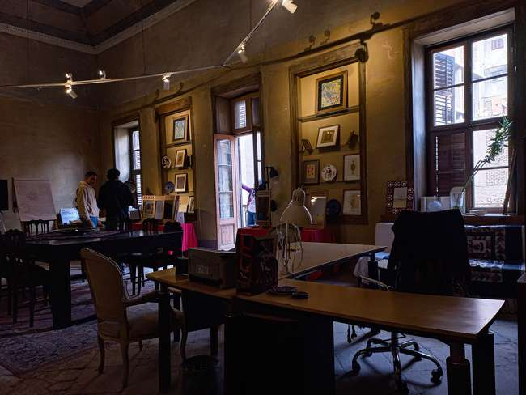
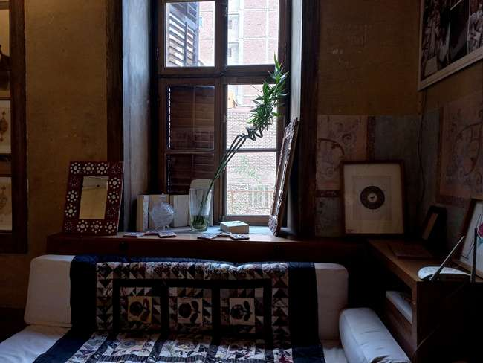
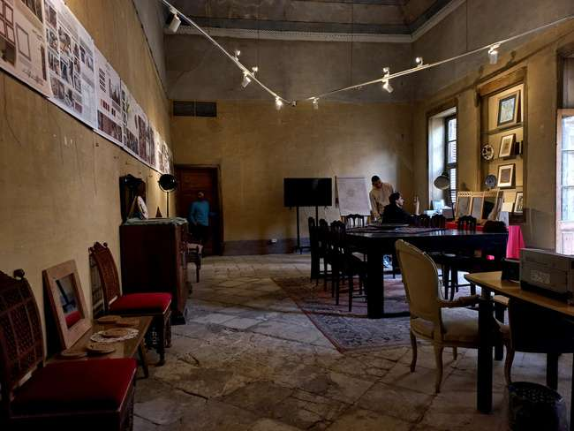
You’re here!
See inside
FIRST FLOOR
PLAN

Slide 13
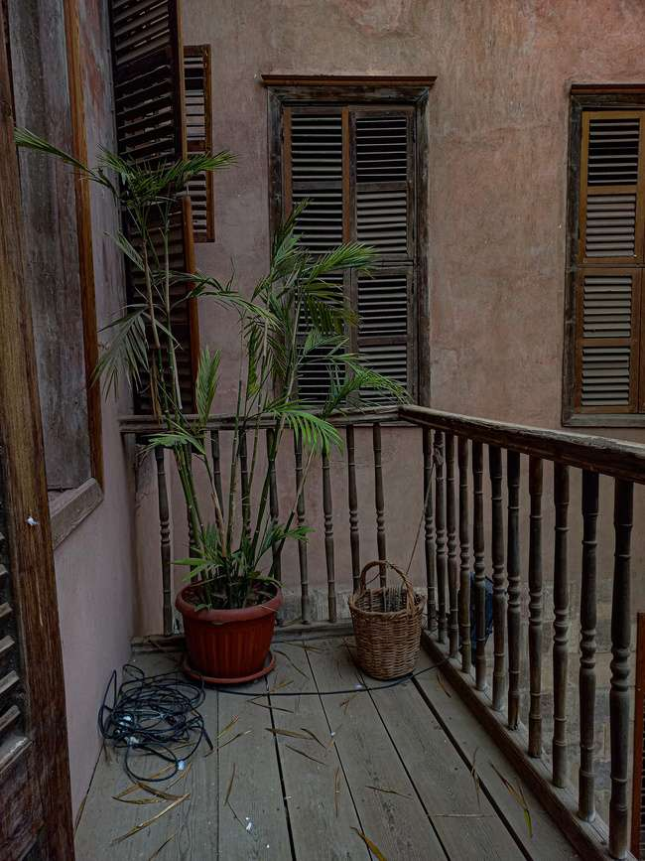
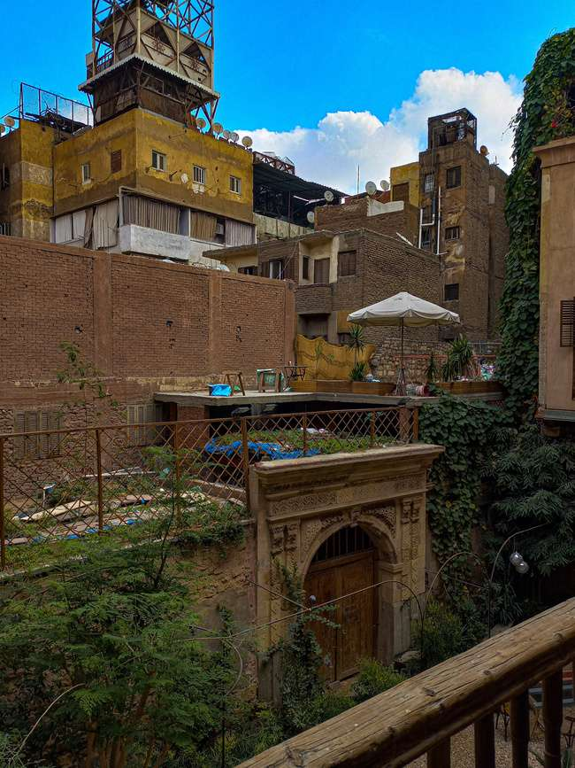
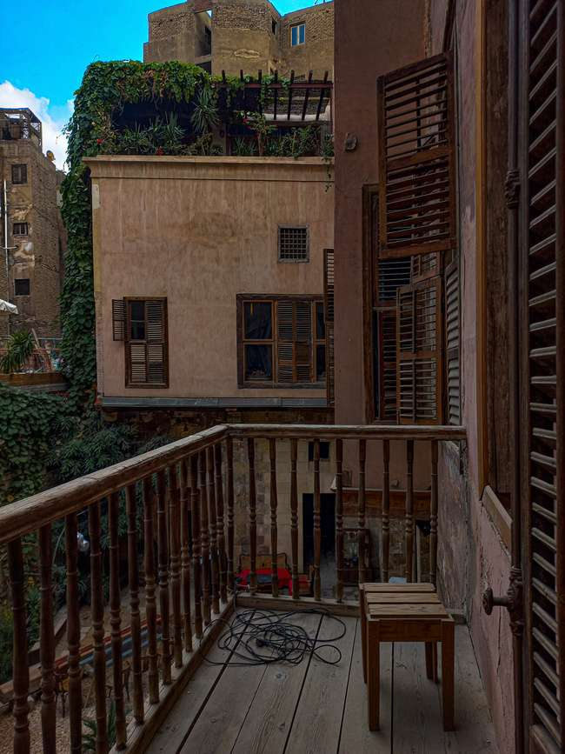
Hadeel Zakaria
VISIONARY BY DESIGN
View from the balcony
PLAN

Slide 14
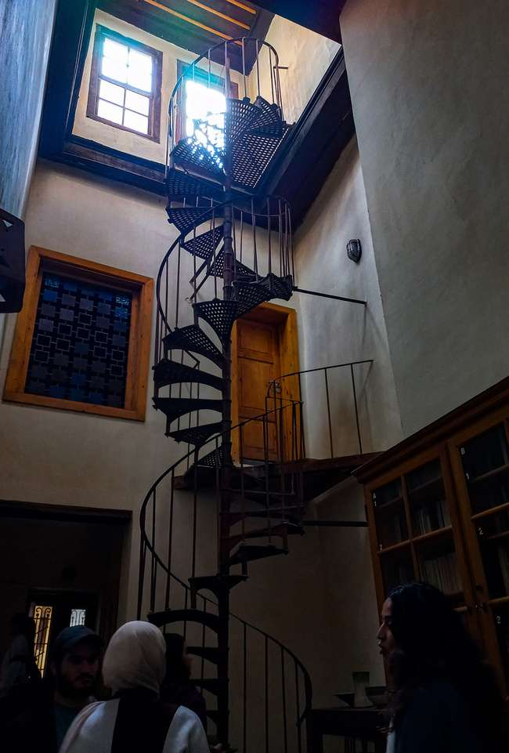
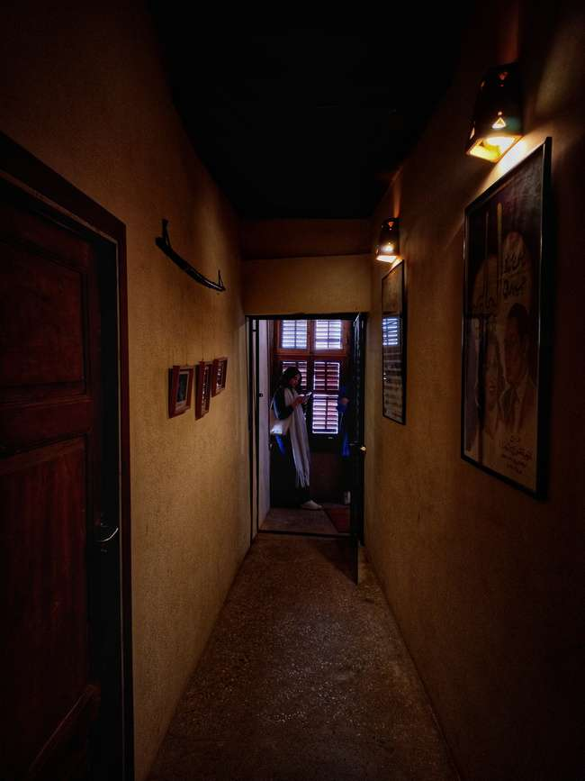
You’re here!
See inside
FIRST FLOOR
Taking this corridor, it will take you to the library
PLAN

Slide 15
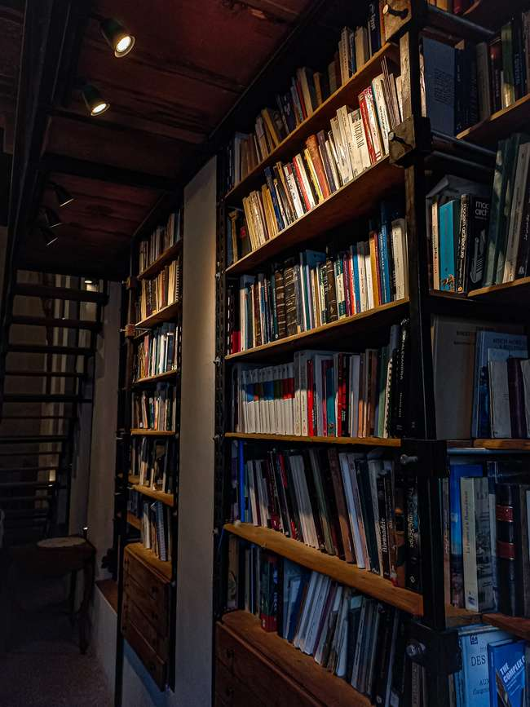

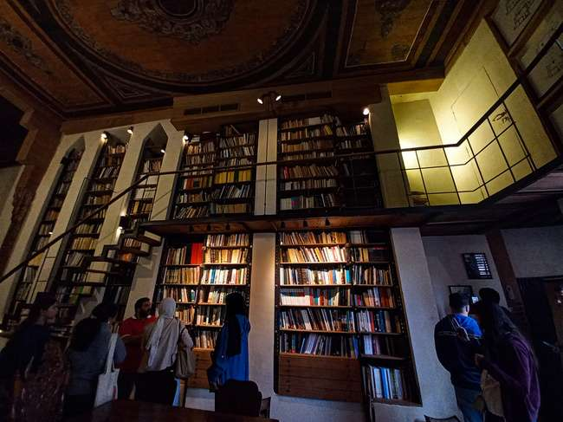
You’re here!
See upstairs
FIRST FLOOR
PLAN
PLAN

Slide 16
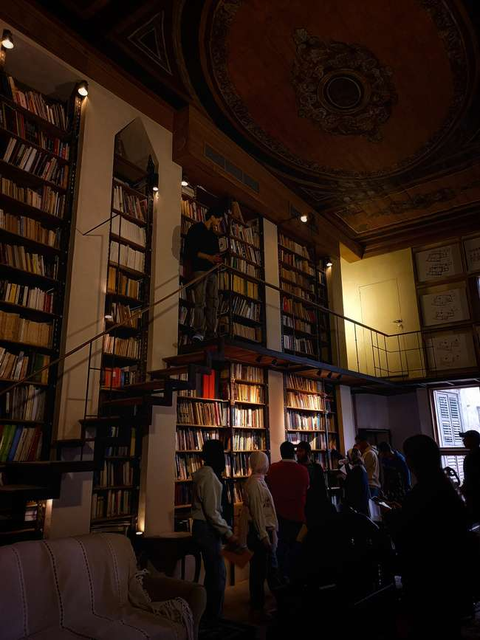
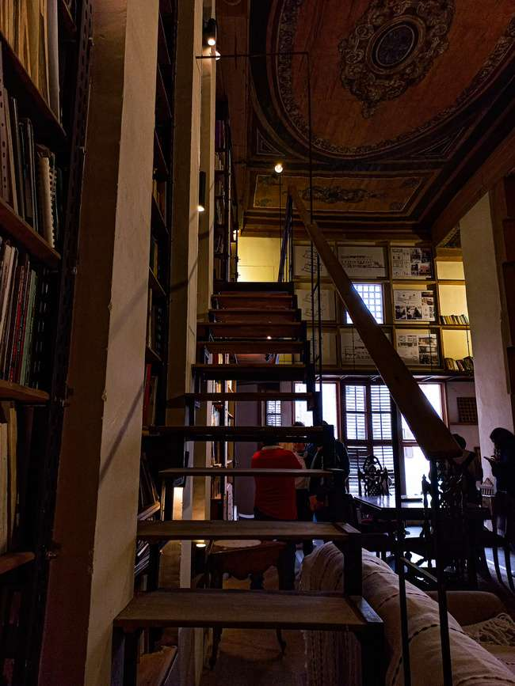
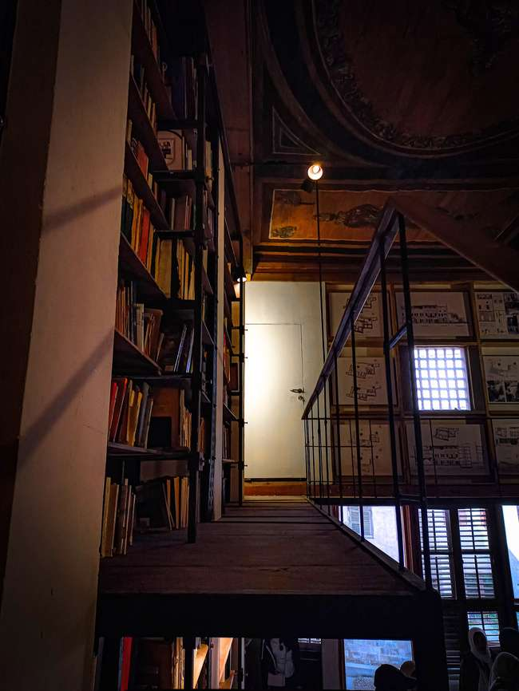
PLAN

Slide 17
Courtyard!
GROUND FLOOR
PLAN

Slide 18
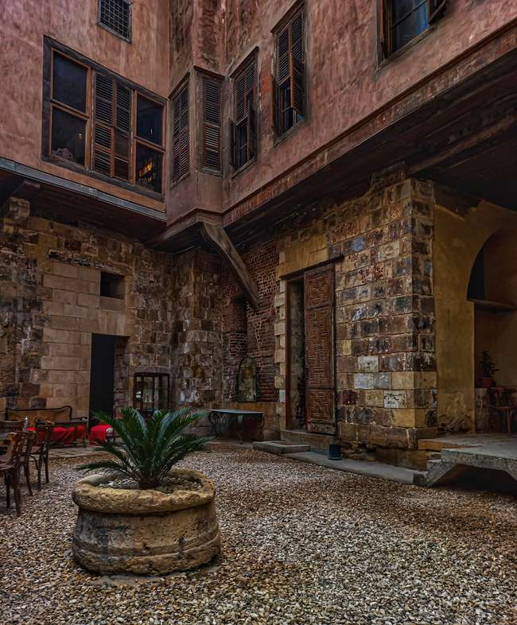
PLAN

Slide 19
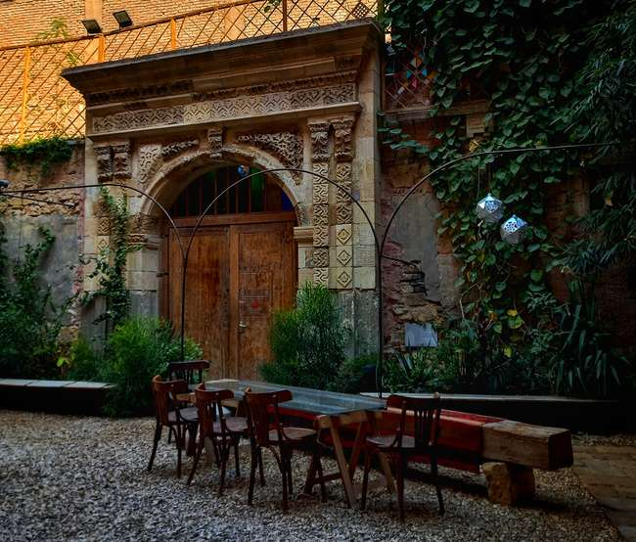
Zoom in
PLAN

Slide 20
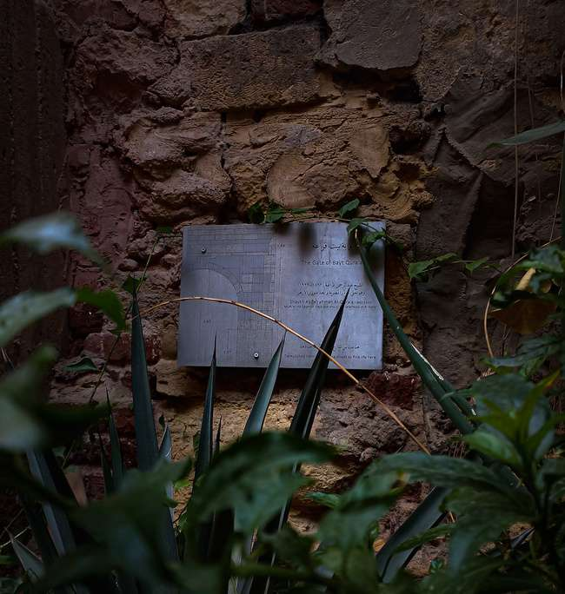
The Gate of Bayt Qura’a
PLAN

Slide 21
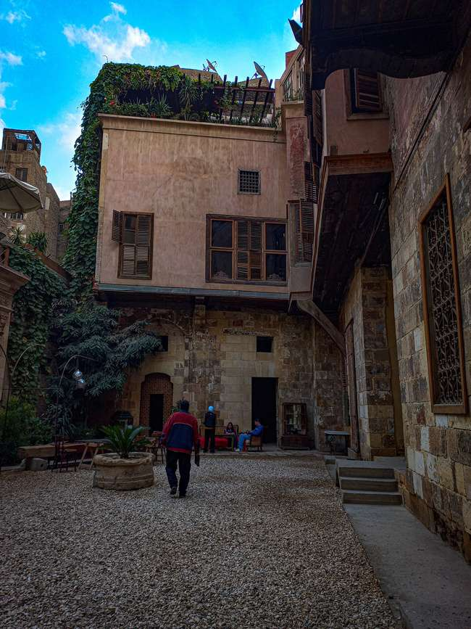
Zoom in
PLAN

Slide 22
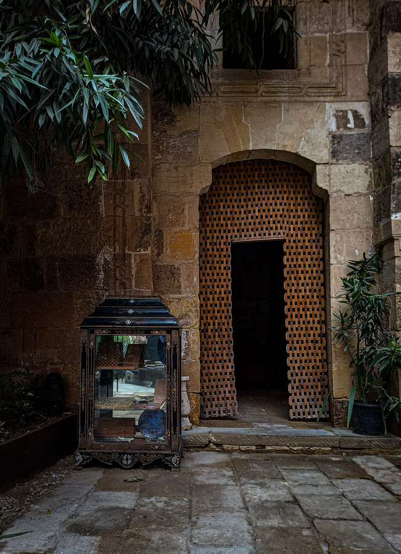
Hadeel Zakaria
VISIONARY BY DESIGN
PLAN

Slide 23
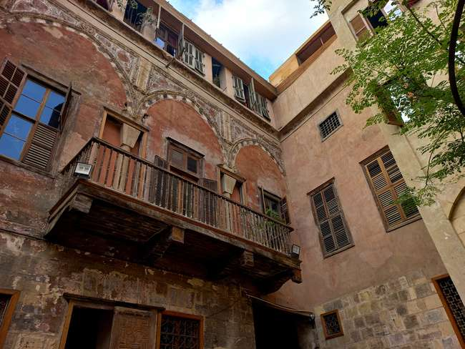
PLAN

Slide 24
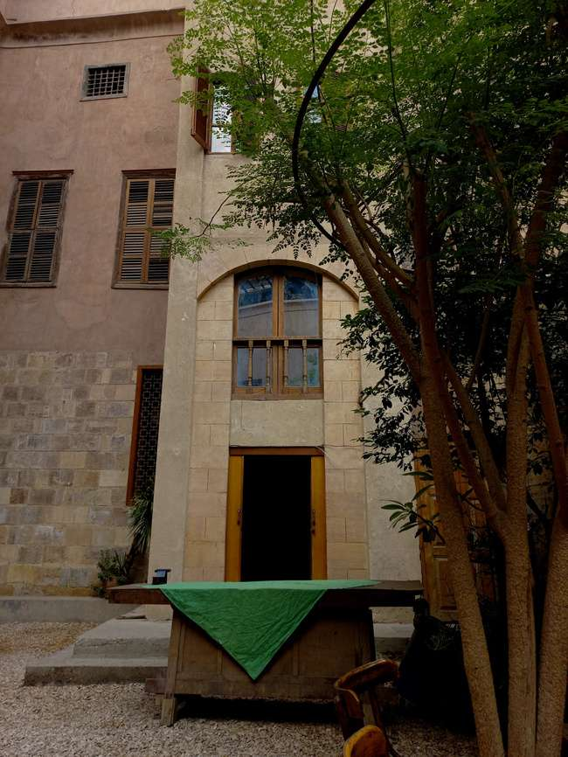
PLAN

